Slide 1
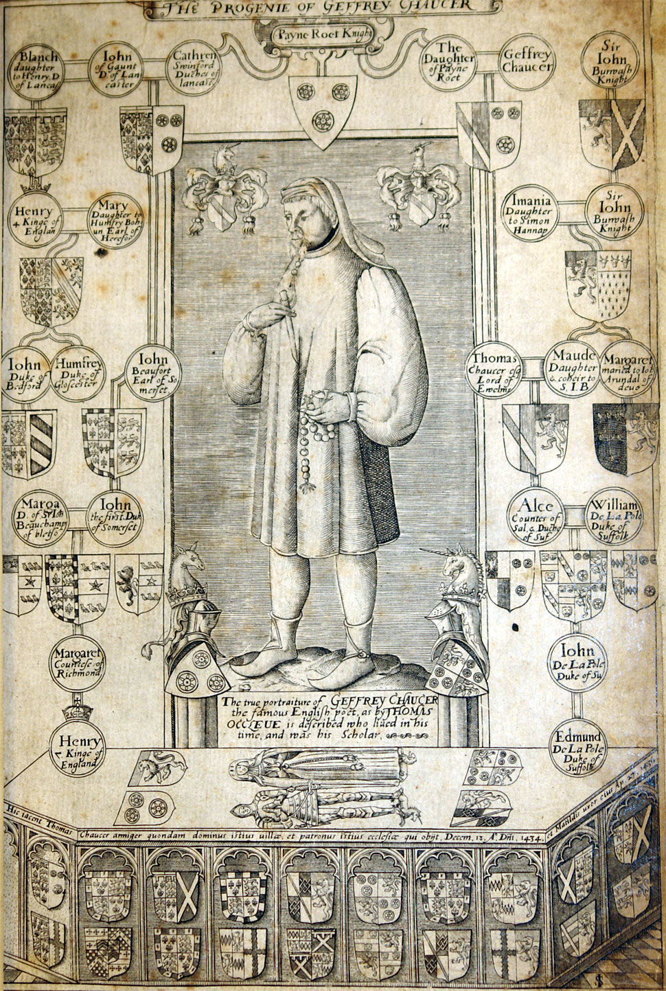
Geoffrey Chaucer

Slide 2
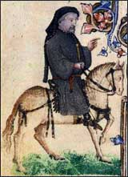
His Life
Geoffrey Chaucer (C. 1343-1400)
Entered King’s (Edward III) service after being ransomed from imprisonment in France.
Married Phillipa
Richard II accedes the throne; Chaucer remains in service to the King.

Slide 3
His Work
Began by writing French and Latin religious poetry
Creates The Canterbury Tales

Slide 4
“Summoner’s Tale”
This frere bosteth that he knoweth helle,
(Translation) This friar boasts that he knows hell,
And God it woot, that it is litel wonder;
(Translation) And God knows that it is little wonder;
Freres and feendes been but lyte asonder.
(Translation)Friars and fiends are seldom far apart.

Slide 5
The Canterbury Tales
Chaucer started on The Canterbury Tales in the early 1380s.
This is a collection of stories told by pilgrims on the road to the cathedral at Canterbury; these tales will shape English literature.

Slide 6
The Canterbury Tales
The Canterbury Tales are notable for:
Narrative (story)
Varied characters
Chaucer drew on real life pilgrims.
Chaucer had many jobs in medieval society that exposed him to many different people.
he worked as a page, soldier, messenger, valet, bureaucrat, foreman and By shaping their speech his literature became popular among the different people.

Slide 7
The Pilgrims
The tales are told as a story-telling contest by pilgrims visiting the Shrine of Saint Thomas Beckett (1118-1170) at the Canterbury Cathedral.
Thomas Beckett was killed by followers of Henry II of England
The people loved Beckett so much that they made annual pilgrimages to Canterbury.

Slide 8
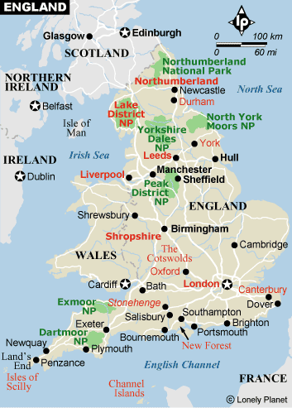

Slide 9
Canterbury Comic
Rubric: 80 Points
Clear/Accurate Story (50 points)
Careful/Colorful Artwork (20 points)
Presentation (10 points)

