Slide 1
I.P.K – Utopia Project
By: Students in 10th Grade Language Arts

Slide 2
Name of our society- I.P.K
IMPORTANT.PEOPLE.KINGDOM

Slide 3


Goals and Objectives?????
Everyone Must Be Happy :]
No Rioting!!!!
EQUALITY!!! (Nobody is a superior!)

Slide 4
System of Government???
- Democrat/Republic

Slide 5
Education system???
Everyone is born knowing ALMOST everything that they need to know.
College is an optional request. People who go to college have full paid tuition and go there for educational opportunity careers.
You cannot be admitted to college until you pass the entrance exam given to you prior to registration

Slide 6
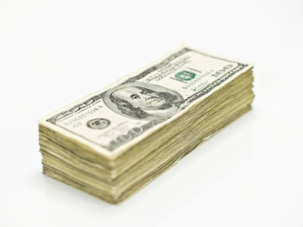
Currency and economy
People who live in I.P.K. only work 3 days a week making a $45 dollars an hour
This means that the people here are making a decent amount of money :] Which in any economy is a good thing

Slide 7
Medical care…
Everyone is covered on the basic Medicaid plan. Your benefits are never increased or decreased :]] and we will NOT take any benefits away as long as you are covered by the premium! :]
Even if you are not a standard citizen of our society we will give temporary benefits to citizens who move or change cities/districts
Any mother who becomes pregnant and the baby has a medical deficiency will have a euthanization that will make the baby function normally.

Slide 8
Our laws…
NO DRIVING DRUNK!!!!! We will put you in Jail for 2 years and you will have to pay a fine and do community service Jail time and is severity depends on how intoxicated you are
Keep streets clean!!! No drugs. We want a clean environment to raise our kids in. if caught with drugs you will be imposed with a fine and attend a seminar based on drug and law enforcement.

Slide 9
How dO I pay???
Since we don’t have money transactions are paid in a pay it forward manner this means that whatever you do as a volunteer service is transacted as a means of paying for what you took or have.

